Slide 1
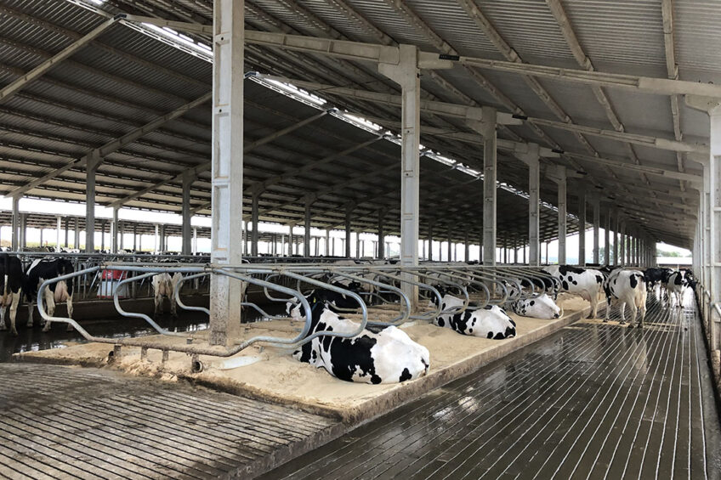
Manure management in a diary livestock farm
Sustainable Practices for Environmental Protection

Slide 2
introduction
Manure management is a critical aspect of dairy livestock farming, as it affects
Environmental quality
Manure lead to emissions of the GHG’s like methane as well environmental degradation,
Negative health impacts
Loss of valuable nutrients that could be added to soil.
Animal health
Farm productivity
Dairy cows produce approximately 40-50 kg of manure per head per day.
(ASABE, 2017)

Slide 3
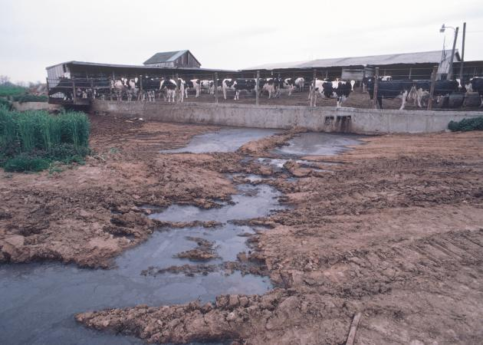
Environmental impacts
Improper manure management can lead to water pollution, soil degradation, and air quality issues (WHO, 2018)
Harming aquatic life
Ammonia release
Methane gas
Pathogens which can
cause serious health
risks for humans.

Slide 4
Conti…
The dairy effluents are responsible for causing foul odor and turbidity in the water. The organic concentration present in the effluent becomes toxic to the aquatic ecosystem.
Casein is one of the main compounds released from the dairy manure. When subjected to degradation, it turns into highly foul-smelling black-coloured waste.

Slide 5
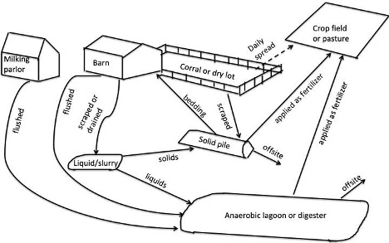
Manure management strategies
Effective manure management involves collection, storage, treatment, and utilization (NRCS, 2019).

Slide 6
Manure management strategies
Collection
Scraping
Flushing
Vacuuming
Storage
Lagoons
Tanks
Piles
Treatment
Anaerobic digestion
Composting
Aeration
Utilization
Fertilizer
Energy production
Bedding material

Slide 7
Collection of manure
Collection method of manure on a dairy farm depend on following situations:
Cost
Type of bedding
Design of farm
Availability of labor
Depending on the things described upper, collection can be done using:
Skid steers
Using mechanical systems such as:
Alley scrapers
Gutter cleaners
By gravity using slatted floors
By flush systems that wash manure to a collection point.

Slide 8
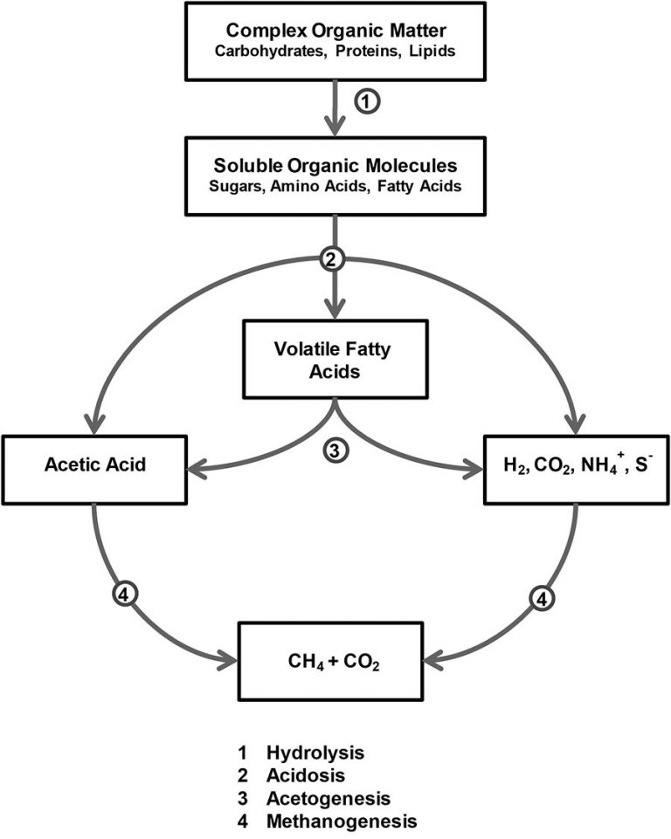
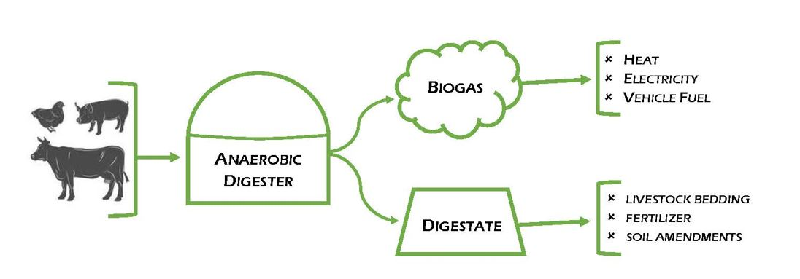
Anaerobic digestion
Anaerobic digestion is a treatment process that converts manure into biogas (CH4 and CO2) and nutrient-rich digestate.
(WEF, 2019)

Slide 9
Transformations of Organic N Contained in Manure
Dairy animals consume a plant-based diet that is ground and fragmented through mastication before undergoing chemical and enzymatic degradation in the digestive tract.
Organic N represents 18–94% of the total N in manure.
During storage, the organic nitrogen of manure is converted via physicochemical and microbial processes into plant available inorganic species, such as ammonia (NH₃), nitrite (NO₂⁻), and nitrate (NO₃⁻)

Slide 10
Pathogens removal/ reduction
There are several types of microbes and micro flora which plays a vital role in the treatment of manure. But a handsome amount of which are pathogens.
Most concerning thing is that pathogens may become dormant and again start disease spreading when conditions become favorable again
Most common practice for pathogens inactivation is effective storage.
Essentially, no fresh manure can be added to the pile before during storage.
Common pathogens of dairy manure:
E. Coli
Salmonella
Yersinia
Campylobactor
Cysts
Giardia
Cryptosprodium

Slide 11
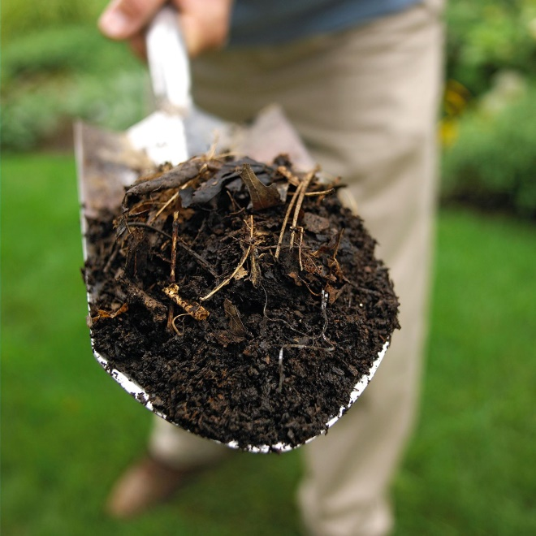
Composting
Composting is a treatment process that converts manure into a stable, humus-like material
(EPA, 2020)
Manure needs to be managed properly to be composted properly.
Carbon/nitrogen ratios should be about 30-to-1, moisture content should be around 50% and oxygen needs to be incorporated routinely by turning.
(Mary A, 2022)

Slide 12
Manure utilization
Manure
Land application
Green manure
Slurry
Bio energy production
Bedding material
Compost
Biogas
Nutrients extraction
Nitrogen
Phosphorus
Dairy manure contain more than 80% of organic N which are available for plants; thus can be utilized as fertilizer. Adso, energy source, or bedding material
(NRCS, 2019)
One of the main goals of utilizing of manure is to salvage its nitrogen and phosphorus and potassium portion.

Slide 13
Beneficial aspects
Economic benefits
Effective manure management can:
Reduce waste disposal costs
Generate revenue through energy production
Enhances the organic farming
Improve crop yields (USDA, 2019)
Social benefits
Proper manure management can:
Improve community health,
Reduce odors and nuisance
Enhance environmental quality (WHO, 2018)
Conclusion
“Inadequate manure management practices have significant environmental risks, threatening the production cycle in ecosystems and human health. The consequences of inadequate manure handling and disposal are far-reaching, with devastating effects on water quality, soil fertility, air purity, and climate stability.”

Slide 14
Personal recommendations
This microbial consortium is an effective and economical biological solution to treat dairy industry wastewater.
It is time for industries and organizations to take action and be accountable for the waste generated at their farms by evaluating cost-effective, sustainable, easily accessible, and completely natural solutions.
Need of the hour is to potential reduction of methane emissions from dairy farming systems. Because dairy sector is the largest sector of livestock; thus produced largest amount of manure.

Slide 15
References
Marklein, A. R., Meyer, D., Fischer, M. L., Jeong, S., Rafiq, T., Carr, M., & Hopkins, F. M. (2021). Facility-scale inventory of dairy methane emissions in California: implications for mitigation. Earth System Science Data, 13(3), 1151–1166. https://doi.org/10.5194/essd-13-1151-2021
Douglas-Mankin, K. R. (2018). Current Research in Land, Water, and Agroecosystems: ASABE Journals 2017 year in review. Transactions of the ASABE, 61(5), 1639–1651. https://doi.org/10.13031/trans.12821
Domke, G. M., Walters, B. F., Nowak, D. J., Smith, J. E., Ogle, S. M., Coulston, J., & Wirth, T. (2020). Greenhouse gas emissions and removals from forest land, woodlands, and urban trees in the United States, 1990-2018. https://doi.org/10.2737/fs-ru-227
Mazurkiewicz, J. (2023). The impact of manure use for energy purposes on the economic balance of a dairy farm. Energies, 16(18), 6735. https://doi.org/10.3390/en16186735
Manure Management - Virtual farm. (n.d.). Virtual Farm. https://virtualfarm.psu.edu/dairy-farm-manure-management
Anaerobic Digestion of Animal manures: Understanding the basic Processes - Oklahoma State University. (2017, March 1). https://extension.okstate.edu/fact-sheets/anaerobic-digestion-of-animal-manures-understanding-the-basic-processes.html
Liu, Z., & Wang, X. (2020). Manure treatment and utilization in production systems. In Elsevier eBooks (pp. 455–467). https://doi.org/10.1016/b978-0-12-817052-6.00026-4
Bicudo, J. R., & Goyal, S. M. (2003). Pathogens and manure management systems: A review. Environmental Technology, 24(1), 115–130. https://doi.org/10.1080/09593330309385542

